Slide 1
Technology Meets Rhetoric:
A Rogerian Methodological Review of the Visual Rhetoric of Websites
Concerned with Abortion
PowerPoint to Accompany
LifeTech Conference Presentation
Dayton, Ohio
6 September 2014
Dr. Jeff Koloze
DrJeffKoloze@att.net
216-262-3511

Slide 2
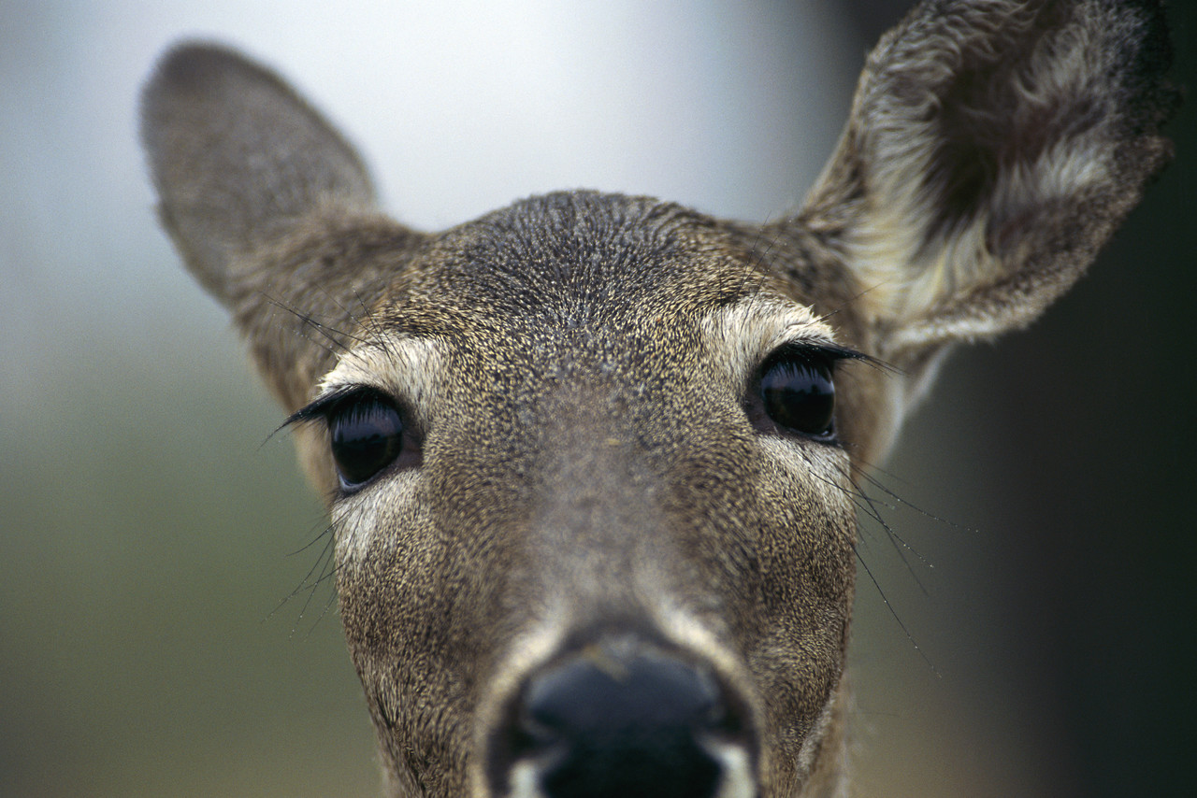
Agenda
Standards which information processing professionals recommend for websites
Key aspects of the Aristotelian and Rogerian methods of argumentation (followed by two quizzes)
Analysis of representative websites concerned with abortion
Questions, answers, or utterly hopeless deer-in-the-headlight stares from me

Slide 3
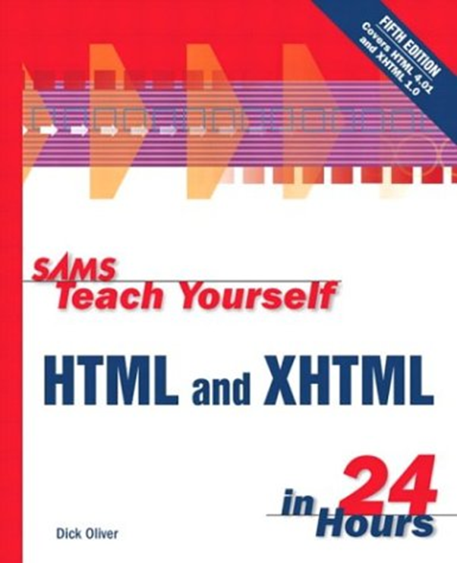
Dick Oliver and Charles Ashbacher,
Sams Teach Yourself HTML and XHTML in 24 Hours (5th ed., 2001)
“Get a computer”, “get a connection to the Internet”, “get a Web browser program”, “explore!” ([9]-11)
Background color: “white to match the background that most Web browsers use” (140)
16 standard Windows colors (162)
World Wide Web Consortium (w3.org; [409])
Webpagesthatsuck.com

Slide 4
Dick Oliver and Charles Ashbacher,
Sams Teach Yourself HTML and XHTML in 24 Hours (5th ed., 2001) (cont.)
“The first page that a visitor sees should always begin by explaining what the site is about and provide enough introductory information to ‘hook’ the intended audience while getting rid of anyone who really has no interest. [….] In all aspects of your site design, keep in mind the following fact: Studies have repeatedly shown that people become confused and annoyed when presented with more than seven choices at a time, and people feel most comfortable with five or fewer choices. Therefore, you should avoid presenting more than five links (either in a list or as graphical icons) next to one another and never present more than seven at once.” (341-3)

Slide 5

Mark Bell,
Build a Website for Free (2009)
“Keep things as simple as possible” (39)
15% of page as header
Another 15% as footer (37)
“Magic four” colors: red, yellow, black, and white (44)

Slide 6
Mark Bell,
Build a Website for Free (2009)
Three planning questions:
  “Why am I building this website?”
  “What are the website’s goals?”
  “Who [sic] do I want to visit my website?” (13)
Content should be “personal”, “high quality”, and “unique” (76)

Slide 7
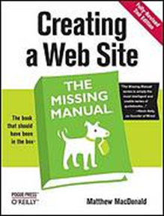
Matthew MacDonald,
Creating a Web Site: The Missing Manual (2nd ed., 2009)
“If you want to be really conservative, you won’t go wrong with any of these fonts: Times, Arial, Helvetica, Courier” (157)
“Once you pinpoint your Web site’s raison d’être, you should have a better idea about who your visitors will be. Knowing and understanding your audience is [sic] crucial to making your Web site effective.” (17)
“Keep it simple” (19)
“Be consistent”
“Know your audience” (20)

Slide 8
Matthew MacDonald,
Creating a Web Site: The Missing Manual (2nd ed., 2009)
Domaindirect.com
Open Directory Project (http://dmoz.org 313)
Adding URL directly on Google (www.google.com/addurl 317)
Amazon’s affiliate program (http://affiliate-program.amazon.com/ 381)

Slide 9
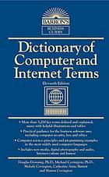
“Web Page Design”,
Dictionary of Computer and Internet Terms (2013)
“Decide on the purpose of your web page.
Plan for maintainability.
If you want people to visit your web site repeatedly, put something useful there [….]
Do not draw attention to the wrong things.
Remember that you do not have a captive audience.
Remember that some people still use older browsers.
Use dark type on a white background for anything the reader may need to print out.
Attach links to informative words, not the word ‘here’.” (547)

Slide 10
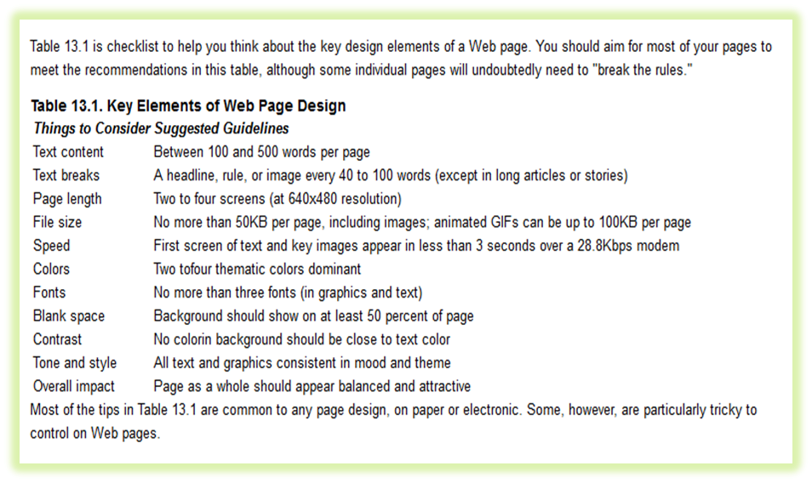
Dick Oliver,
Sams Teach Yourself HTML 4 in 24 Hours (online, 2014)

Slide 11
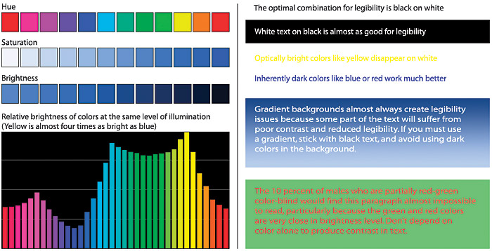
Patrick J. Lynch and Sarah Horton,
Web Style Guide (3rd ed., 2011)

Slide 12
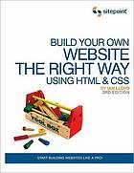
Ian Lloyd, Build Your Own Website the Right Way Using HTML & CSS
(3rd ed., 2011)
“Just as Jupiter sits there in our solar system, sucking in most of the errant space dust and asteroids that swing past it like some astronomical vacuum cleaner, Facebook is this monstrous (in size, not nature…or not always!) presence, drawing in ever more people. And for many people, once they arrive, they’re content to never leave.” (302; italics in original)

Slide 13
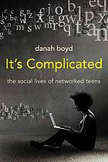
Danah Boyd, It’s Complicated:
The Social Lives of Networked Teens (2014)
“Networked publics are publics that are restructured by networked technologies. As such, they are simultaneously (1) the space constructed through networked technologies and (2) the imagined community that emerges as a result of the intersection of people, technology, and practice.” (8; italics added)

Slide 14
Danah Boyd, It’s Complicated:
The Social Lives of Networked Teens (2014) (cont.)
“Wikipedia can be a phenomenal educational tool, but few educators I met knew how to use it constructively. Unlike other sources of information, including encyclopedias and books by credible authors, the entire history of how users construct a Wikipedia entry is visible. By looking at the ‘history’ of a page, a viewer can see when someone made edits, who did the editing, and what that user edited. By looking at the discussion, it’s possible to read the debates that surround the edits. Wikipedia isn’t simply a product of knowledge; it’s also a record of the process by which people share and demonstrate knowledge.” (188-9)

Slide 15
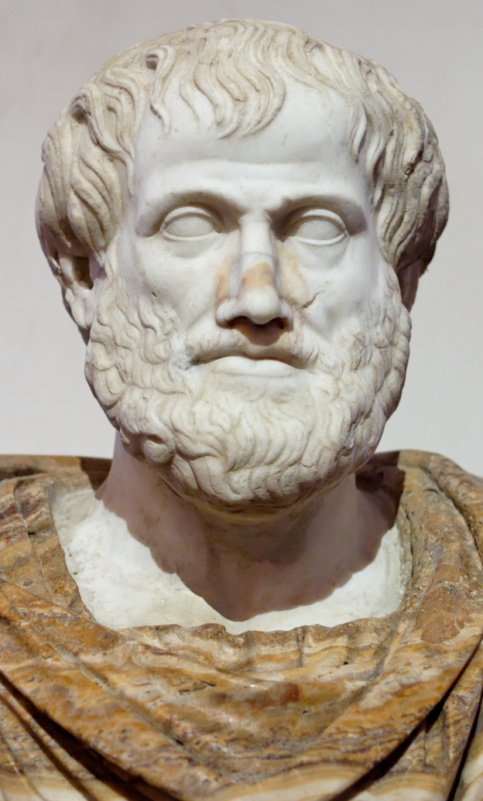
Key Aspects of Aristotle’s Method of Argumentation
Ethos (credibility)
Kairos (the appropriateness of the situation)
Logos (the use of logic and the avoidance of fallacies)
Pathos (emotions)
Result is to convince another person to adopt one’s perspective

Slide 16
Quiz on Aristotle’s Method Applied to Pro-Life Issues
55-year-old white male speaking before African Americans about the high abortion rate in that demographic
22-year-old stay-at-home mother blogging about biomedical issues
Male activist showing bloody pictures of aborted babies before a group of agnostic millennials
Byzantine Catholic senior citizen woman wearing a crucifix speaking before a congregation of Orthodox Jews about Nazi atrocities and euthanasia

Slide 17

Key Aspects of Carl Rogers’ Method of Argumentation
Aims for common ground on a controversial issue
Based on “empathic listening”
One can respect and, optimally, understand, if not agree with, an opponent’s position
“Collaborative negotiation”
Result is not necessarily to convince, but to reach consensus, albeit a tentative one (Ramage et al. 141-3)

Slide 18
Quiz on Rogers’ Method Applied to Pro-Life Issues
55-year-old white male speaking before African Americans about the high abortion rate in that demographic
22-year-old stay-at-home mother blogging about biomedical issues
Male activist showing bloody pictures of aborted babies before a group of agnostic millennials
Byzantine Catholic senior citizen woman wearing a crucifix as she speaks speaking before a congregation of Orthodox Jews about Nazi atrocities and euthanasia

Slide 19
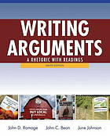
Ramage, Dean, and Johnson,
Writing Arguments: A Rhetoric with Readings (9th ed., 2012)
“On issues such as abortion, gun control, gay rights, or the role of religion in the public sphere, the distance between a writer and a resistant audience can be so great that dialogue seems impossible. In these cases the writer’s goal may be simply to open dialogue by seeking common ground—that is, by finding places where the writer and audience agree. For example, pro-choice and pro-life advocates may never agree on a woman’s right to an abortion, but they may share common ground in wanting to reduce teenage pregnancy. There is room, in other words, for conversation, if not for agreement.” (135; italics added)

Slide 20
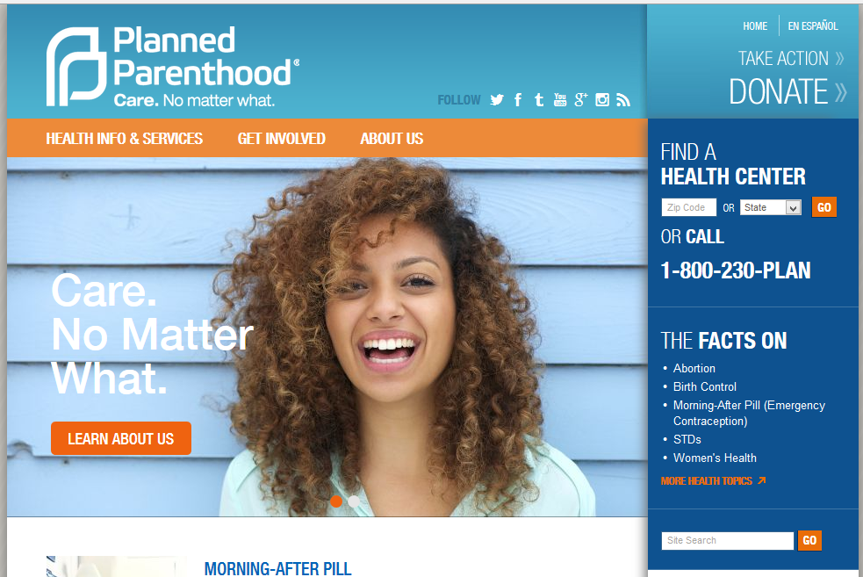
Analysis of Anti-Life Website: http://www.plannedparenthood.org/

Slide 21
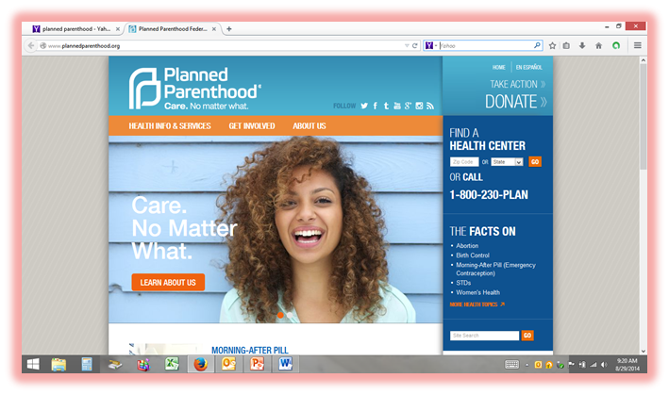
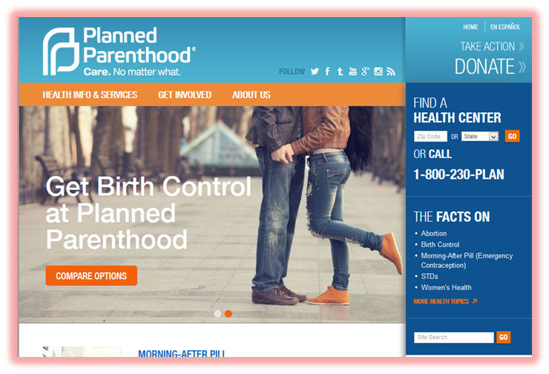
Analysis of Anti-Life Website:
Two Slides on Home Page

Slide 22
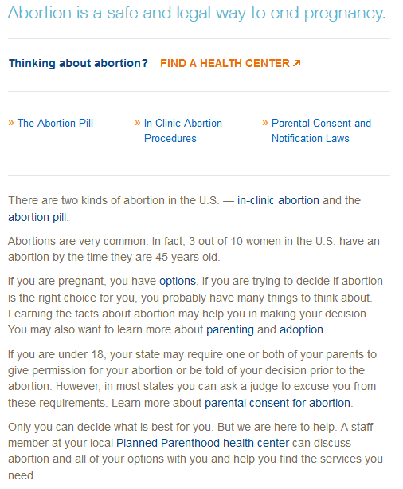
Analysis of Anti-Life Website: http://www.plannedparenthood.org/ health-info/abortion

Slide 23
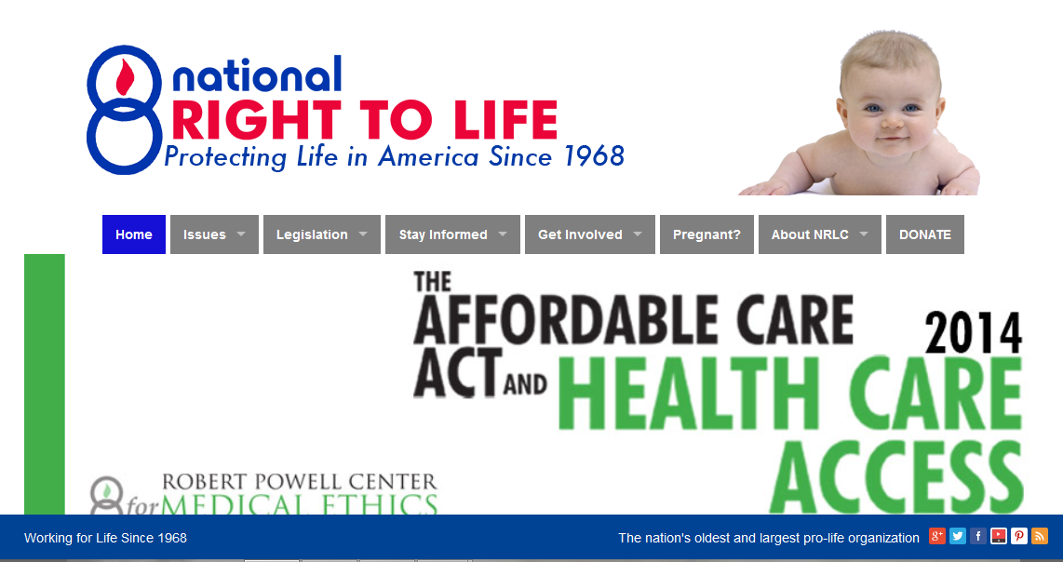
Analysis of Pro-Life Website: http://www.nrlc.org/

Slide 24
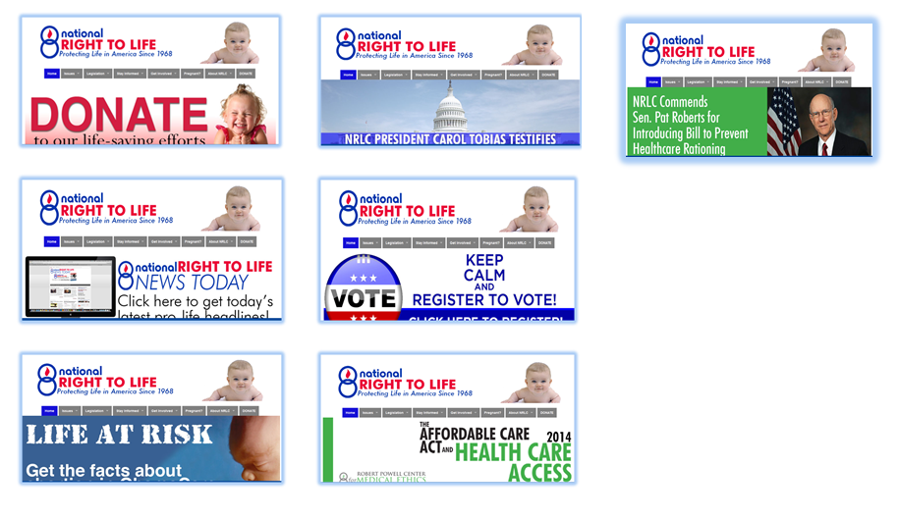
Analysis of Pro-Life Website:
Seven Slides on Home Page

Slide 25
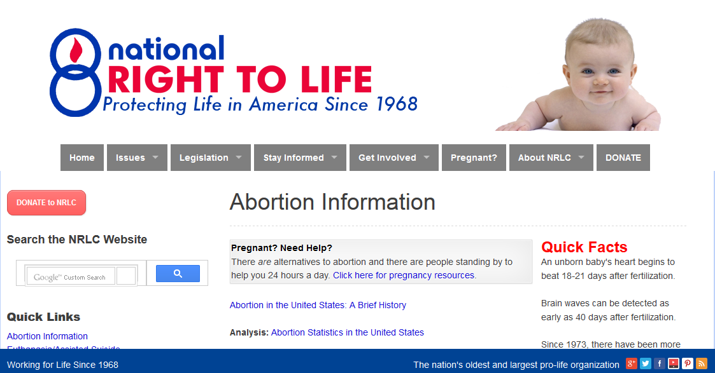
Analysis of Pro-Life Website: http://www.nrlc.org/abortion/

Slide 26
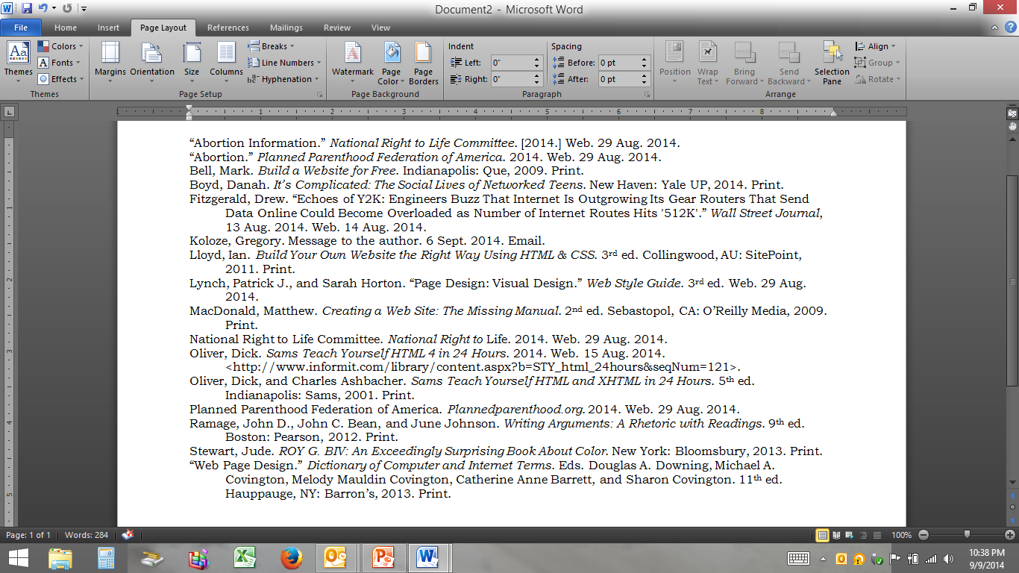
Works Cited

