Slide 1
Right-to-Life Issues in Academia: Political Correctivity in American Higher Education and Strategies for Pro-Life Students in a Hostile College or University Environment PowerPoint to Accompany Presentation for the National Right to Life Convention Kansas City, Kansas 30 June 2018 Dr. Jeff Koloze DrJeffKoloze@att.net 216-262-3511

Slide 2
Agenda
Reiterate major finding discussed in last year’s presentation (7%)
Highlight significant changes in past year (20%)
Recommend practical strategies that students, faculty, and administrators can use to overcome anti-life political correctivity; audience reviews case studies (73%)
Questions and Answers, or Utterly Hopeless Deer-in-the-Headlight Stares

Slide 3
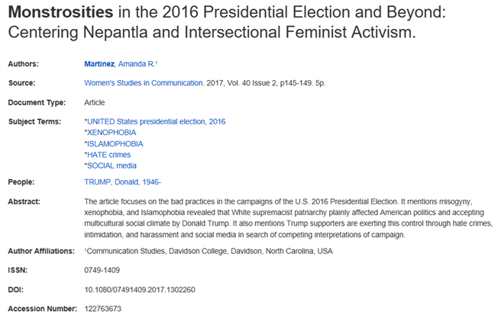
I. Abstract of Amanda R. Martinez’ Research (2017)
Screen print source: Academic Search Complete

Slide 4
Why the Koloze Household Was Wildly Rejoicing at 3 AM on 9 November 2016, Hours After Election Day—and Not Just Because Dr. Koloze is Italian

Slide 5
II. Highlight Significant Changes
Carolina Students for Life, an anti-abortion group at the University of North Carolina-Chapel Hill, was intentionally excluded from activities planned by the campus Women’s Center, which also refused to post a link to the group’s website. So group president Stephanie Evans sent a stern but measured letter to the center and copied it to UNC trustees and administrators. In response (to the letter and the media attention that followed), members of the group were invited to a meeting with a high-level administrator and the Women’s Center director. They got a link on the website. The center also posted links to a pregnancy-support service and a site promoting abstinence. Finally, Carolina Students for Life was invited to participate in future abortion-related events. “I don’t think we struck any extraordinary deal,” says Evans. “I think we got what we deserved and what every other student group had gotten.” (50)
Friedman, Rachel Zabarkes. "The Good and the Bad (Plus Some Ugly).”
National Review, vol. 56, no. 19, 11 Oct. 2004, pp. 48-50. EBSCOhost.

Slide 6
II. Highlight Significant Changes
In 1996 a sobering Gallup Poll was released […]: while 47% of women said they were pro-life when they entered college, by graduation, a whopping 73% said they were now pro-choice.
Frighteningly, the pro-life movement was losing 26% of all female students who went through a university program. Clearly, if the movement had any hope of survival in the long run, more needed to be done to reach out to students. […]
In 2006, all of that changed. In that year American Collegians for Life received a sizable start-up grant, changed its name to Students for Life of America (SFLA), hired a professional staff, opened its first national headquarters in Arlington, VA, and launched its historic Pro-Life Field Program.
Since then, Students for Life has gone on to become one of the most active, and most successful, pro-life organizations in the country. (104)
Jalsevac, John. "Hundreds of Pro-Life Student Groups Sweeping Across U.S. College
Campuses." Human Life Review, vol. 36, no. 4, Fall 2010, pp. 104-106. EBSCOhost.

Slide 7
II. Highlight Significant Changes
Earlier […], the Johns Hopkins Spring Fair had attempted to ban Voice for Life, a pro-life student group I founded, from displaying models of fetuses in various stages of development. The committee in charge of the fair said the models would be “triggering and disturbing” to students. But when our group fought back—and Fox News and other media outlets began reporting on the story—the committee relented.
Voice for Life almost didn’t make it off the ground. In 2013 the student government denied our group recognition as an official student club. But we fought that, too, and the student judiciary committee reversed the decision.
Johns Hopkins recently created a Task Force on Academic Freedom to reassess the university’s policies relating to freedom of speech, owing in no small part to our campus activism. You can fight back. (24-5; italics in original)
Guernsey, Andrew. "Dare to Eat a Chicken Sandwich?" Intercollegiate Review, Fall
2015, pp. 24-25. EBSCOhost.

Slide 8
II. Highlight Significant Changes
In 2015, administrators at a North Dakota school district denied applications for two pro-life clubs, calling them too controversial. The district approved the applications only after Christian legal firm Thomas More Society sent a warning letter. […] Clubs in Washington and Virginia faced similar initial denials. And in 2017, a Pennsylvania district tried to restrict a pro-life club’s activities to its own members, forbidding the club from engaging in outreach efforts to other students. Administrators did not back down when Thomas More attorneys intervened, so the students filed a federal lawsuit. To avoid the litigation, the school district in October agreed to let the club operate freely.
Jones, Leigh. “The New Pro-Life Generation: High-School Students Are Organizing
and Engaging in the Fight for Life, Despite Sharp Opposition from Some
Administrators and Peers.” World, vol. 33, no. 1, 20 Jan. 2018, pp. 42-5,
https://world.wng.org/2018/01/the_new_pro_life_generation. Accessed 20 June
2018.

Slide 9
II. Highlight Significant Changes: Google Search: “pro-life”, “students”, and “censorship”

Slide 10
II. Highlight Significant Changes: LifeNews.com Search: “pro-life”, “students”, and “censorship”

Slide 11
II. Highlight Significant Changes: LifeSiteNews.com Search: “pro-life”, “students”, and “censorship”

Slide 12
III. Recommend Practical Strategies: A Faculty Member vs. an Administrator
Teaching duties
Reviewing college policies
Obtaining candidates for faculty positions
Hiring qualified faculty
Training faculty on college systems
Assigning courses on a regular basis
Handling student complaints against faculty
Handling faculty complaints against students
Managing faculty complaints against other faculty
Firing faculty
Serving on college committees
Establishing other college committees
Presenting papers at conferences
Publishing papers, articles, and books

Slide 13
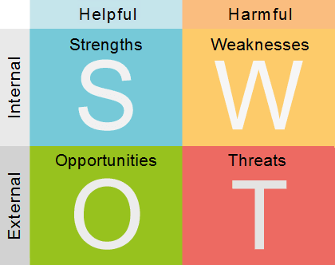
III. Recommend Practical Strategies: SWOT Reversed into TWSO

Slide 14
III. Recommend Practical Strategies: SWOT Reversed into TWSO
Threat:
Immediate threat of politically-correct faculty or institutions

Slide 15
III. LinkedIn Response from a Catholic College President

Slide 16
III. Recommend Practical Strategies: SWOT Reversed into TWSO
Threat:
Immediate threat of politically-correct faculty or institutions
Recommendations:
Appeal to the justice of your pro-life position, making your views a matter of equity
Argue—always politely, yet assertively
Counter whatever negative stereotypes that anti-life faculty may have of pro-life students
Contact the Thomas More Society or University Faculty for Life for legal and academic assistance

Slide 17
III. Recommend Practical Strategies: SWOT Reversed into TWSO
Weaknesses:
Losing the student’s money
Negative public relations
Recommendations:
Vote with your feet to a friendly college if that politically-correct anti-life college does not accommodate your pro-life views
Use social media to publicize censorship of anti-life institutions

Slide 18
III. Recommend Practical Strategies: SWOT Reversed into TWSO
Strengths:
Young
Passion
New perspectives

Slide 19
III. Recommend Practical Strategies: Letter from a Student
I was never able to write anything influenced by my Christian worldview in my classes previous to meeting you. […] You are never afraid to say what you believe (whether it be something Christian, conservative, or pro-life), and I cannot tell you what an impact this has had on me. Please, if you can, do not stop teaching at ***. There are so many students like me who are afraid to say what they believe, and you are the one and only conservative Christian professor speaking truth at *** (that I know of).

Slide 20
III. Recommend Practical Strategies: SWOT Reversed into TWSO
Strengths:
Young
Passion
New perspectives
Recommendations:
Develop hierarchical structure to ensure groups’ continuance
Guide pro-life passion into appropriate channels
Perfect what already is going well

Slide 21
III. Recommend Practical Strategies: SWOT Reversed into TWSO
Opportunities:
Not alone
Faculty are pro-life
Recommendations:
Donate money to pro-life groups
Consider being an academic in your field of interest
Strive for excellence in your scholarship
Take advantage of internships
Aim for the highest degree you can obtain in your field
Call
Development Office
to donate to
NRLC PAC
(202-378-8851)
to arrange monthly credit card donations to get more pro-lifers elected!

Slide 22
III. Recommend Practical Strategies: Resources for Pro-Life Students, Faculty, and Administrators

Slide 23
III. Case Study One: Dr. Hiram Hyperbole teaches Bioethics Law. You like him a lot, especially since he complimented you on your fine work on embryonic stem cell research in your last paper. Should you ask him to be the adviser for your campus pro-life group?
Maybe. Consult RateMyProfessor.com first to get others’ opinions.
No. Anybody who is this old must be a reject from the sixties, probably a hippie.
No. During class, he mentioned the cons and the pros of embryonic stem cell research.
No. His car’s bumper sticker reads “Bernie for President.”
Yes. Another bumper sticker reads “Trump for President.”
Yes. He supports various free speech causes identified on his left-wing blogs.
Yes. The door to his faculty office has a “Hillary for Prison” sticker.
None of the above

Slide 24
III. Case Study Two: Dr. Maria Metaphor is dean of Liberal Arts and a professor of feminist studies. She opposes your pro-life group’s request for funds to bring speakers against the Planned Parenthood abortion business to campus for a lecture on civil rights. What should you do?
Ask Uncle Guido to make her an offer she can’t refuse (he makes the best cannoli).
Begin an online petition, asking people to urge the college to uphold students’ First Amendment free speech rights.
Ignore her; there are other votes on the faculty committee which disburses student activities funds.
Picket her house or the restaurant where she dines
Request a meeting with her to discuss the benefits of having the speaker come to campus.
None of the above

Slide 25
III. Case Study Three: Mr. Sam Synecdoche, an adjunct faculty member, is pro-life; he began a pregnancy support group in Burkina Faso. You want to bring Alveda King to campus to discuss the extreme abortion rate among African Americans. Should you ask him to intercede with the administration?
Don’t even try to invite Alveda King, especially if members of your group are all white.
Maybe. Ask Mr. Synecdoche if he will lose his job over this.
No. The administration will view you as racist, since you are obviously appealing to mere identity politics.
Yes. The administration will not reject a request from a person of color.
Yes. The administration would appreciate anything to assist minority students faced with untimely pregnancies.
None of the above

Slide 26
III. Case Study Four: The anti-life LGBTQ group on campus (not to be confused with the pro-life one) wants your college’s administration to declare your pro-life group a hate group. What should you do?
Consult the appropriate code in the student handbook for guidance on how to respond to the charge.
Contact a pro-life lawyer immediately for guidance.
Gather all group communications (emails, newsletters, etc.) to refute the charge.
Hold an ad hoc dialogue with the LGBTQ community to compare how the unborn, the handicapped newborn, and the elderly are just as vulnerable (if not more so) as persons with same-sex attraction.
I wouldn’t touch this with the proverbial ten-foot pole. Don't even answer here in this workshop! This is too hot an issue.
Post online petitions on Facebook, Gab, LinkedIn, and Twitter among others, asking the college to support your free speech rights.
None of the above

Slide 27
IV. Questions and Answers, or Utterly Hopeless Deer-in-the-Headlight Stares

